Slide 1
The story of St. Brigid

Slide 2
We are told Brigid was born in AD 450 in Faaughart, near Dundalk in Co Louth.
Brigid was the daughter of a wealthy man.
She was also his slave, just as her mother had been.
She spent her days cooking, cleaning and washing. She fed pigs and milked cows on her fathers farm.
In summer she planted the crops and harvested the corn.

Slide 3
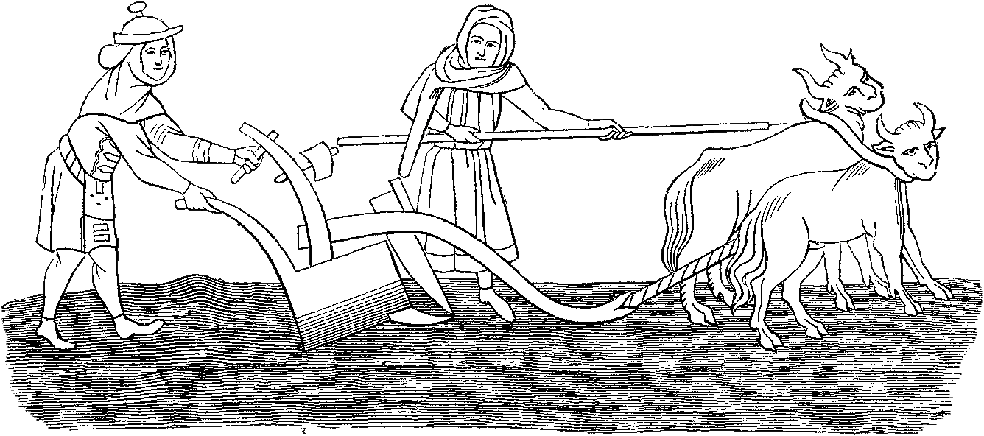
Even though Brigid worked on the farm
from dawn till dusk, she never complained.

Slide 4
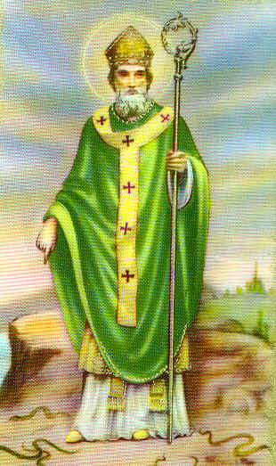
Brigid lived at the same
time as St. Patrick.
She listened to St. Patrick
and became a Christian.
Her father was a pagan.
He didn’t believe in God
and couldn’t understand
why Brigid wished to serve God.

Slide 5
When Brigid turned 18 years old, she no longer worked as a slave.
Her father decided it was time Brigid got married, but Brigid did not want to get married,
Brigid wanted to spend her life working for God.

Slide 6
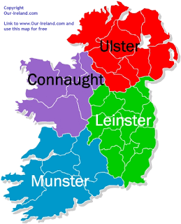
Soon the news about Brigid spread far and wide. Young girls from all over Ireland, came to join her. They wanted to be just like Brigid and help her do her good work.

Slide 7
Brigid was very sad after hearing what her father had said.
With four of her friends, Brigid set of to find the King of Leinster.
When she reached the Curragh of Kildare, she met the King, who was out hunting. The king got of his horse and walked over to Brigid and her friends.

Slide 8
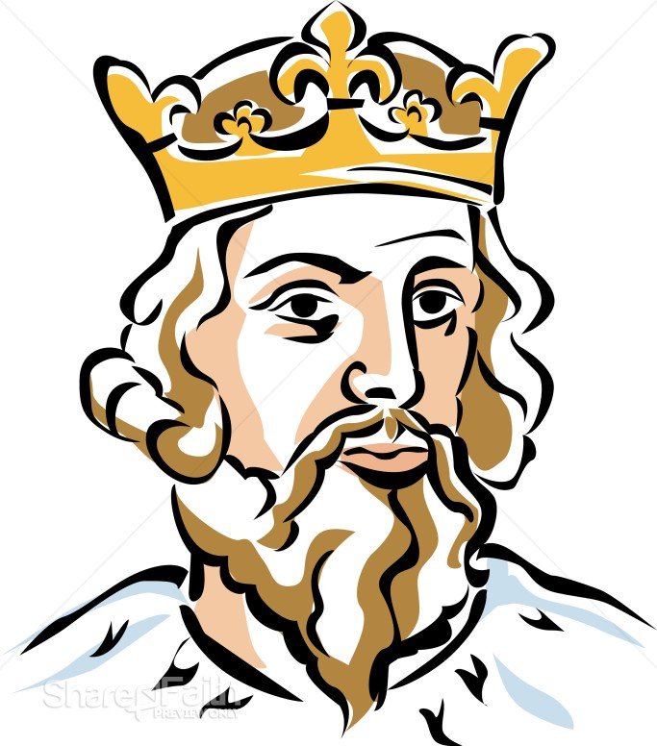
The King of Leinster Laughed.
He would not give away his worst land, so there was no way he was going to give any of his best land to Brigid and her friends.

Slide 9
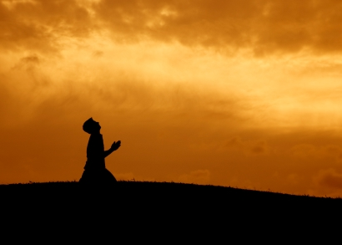
Brigid knelt and started to pray. She asked God to soften the King’s heart.

Slide 10
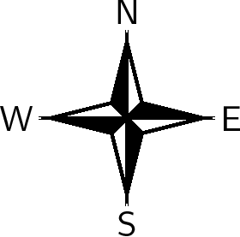
Brigid removed her cloak. She spread it smoothly and evenly on the ground.
Brigid asked her four friends to take a corner each and start walking in
opposite directions.
The four friends started to walk North, South, East and West.

Slide 11
The cloak began to grow in size. The king was amazed.
The cloak grew and grew until it covered many acres of land.
Everyone who saw this, fell to the ground before Brigid and promised to help her always. Even the king feel on his knees.

Slide 12
Soon afterwards, the king became a Christian, and gave much of his wealth to the poor.
Brigid’s miracle of the cloak was the first of many miracles that she worked for the people of Ireland.

Slide 13
The End

