Slide 1
How to make a St Bridget’s Cross
Using pipe cleaners or straws

Slide 2
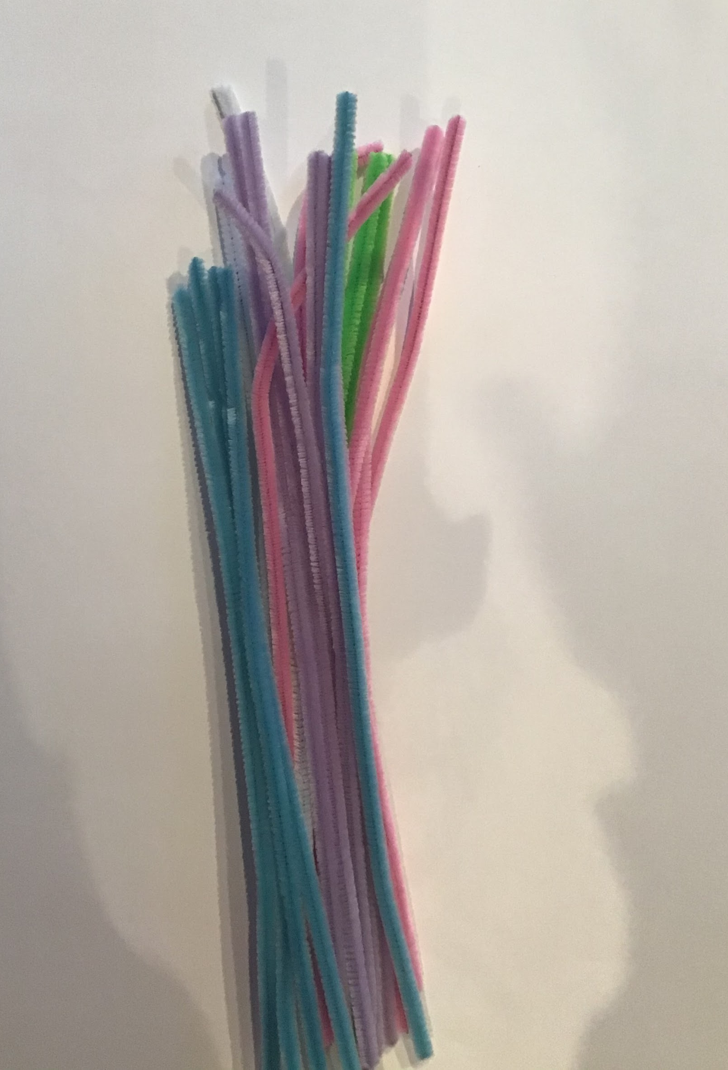
Step 1- use pipe cleaners or straws

Slide 3
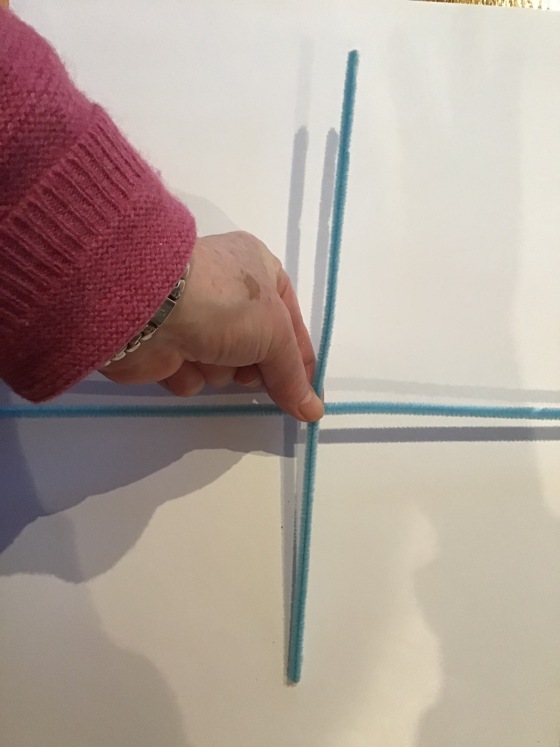
Step 2- use two pipe cleaners to make a cross

Slide 4
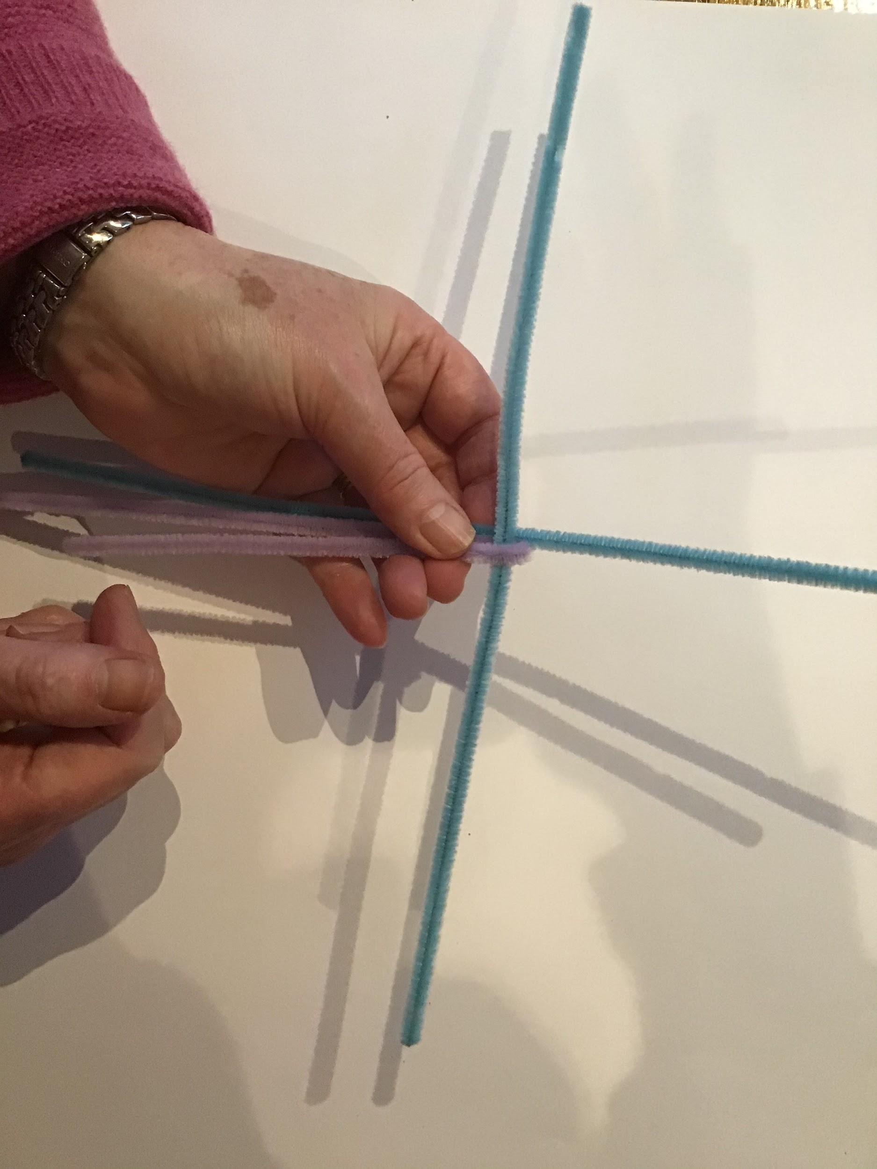
Step 3- Think of the cross as a clock face. Fold a new pipe cleaner over the 3 o’ clock

Slide 5
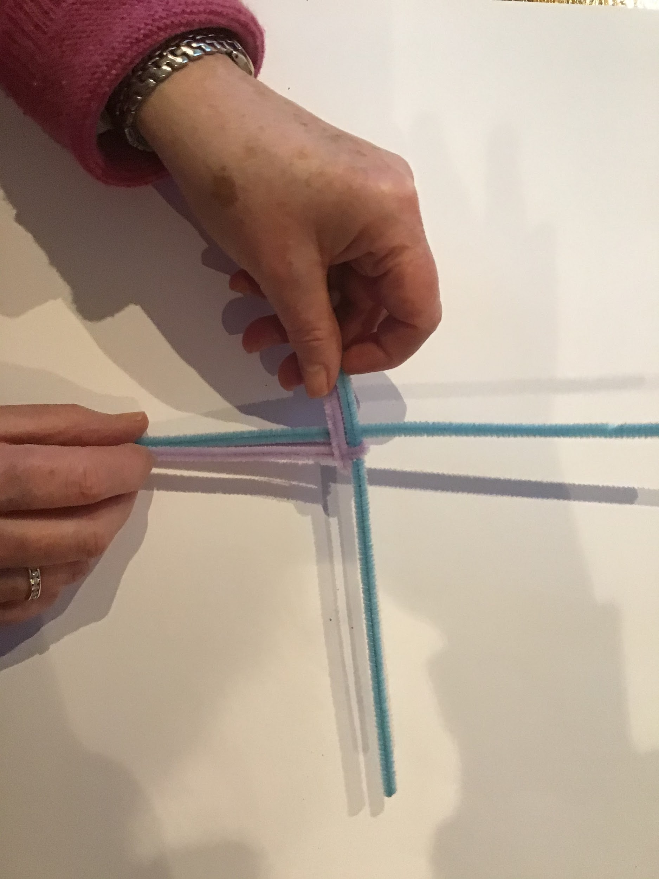
Step 4. Fold a second pipe cleaner over the 6 o’clock, always working clockwise.

Slide 6
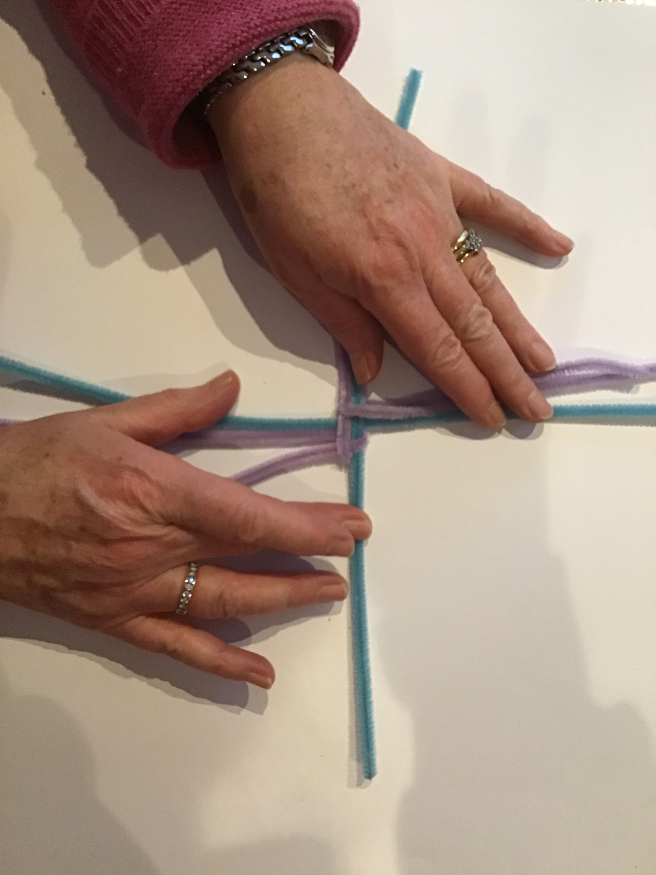
Step 5. Fold the third pipe cleaner over 9 o’clock.

Slide 7
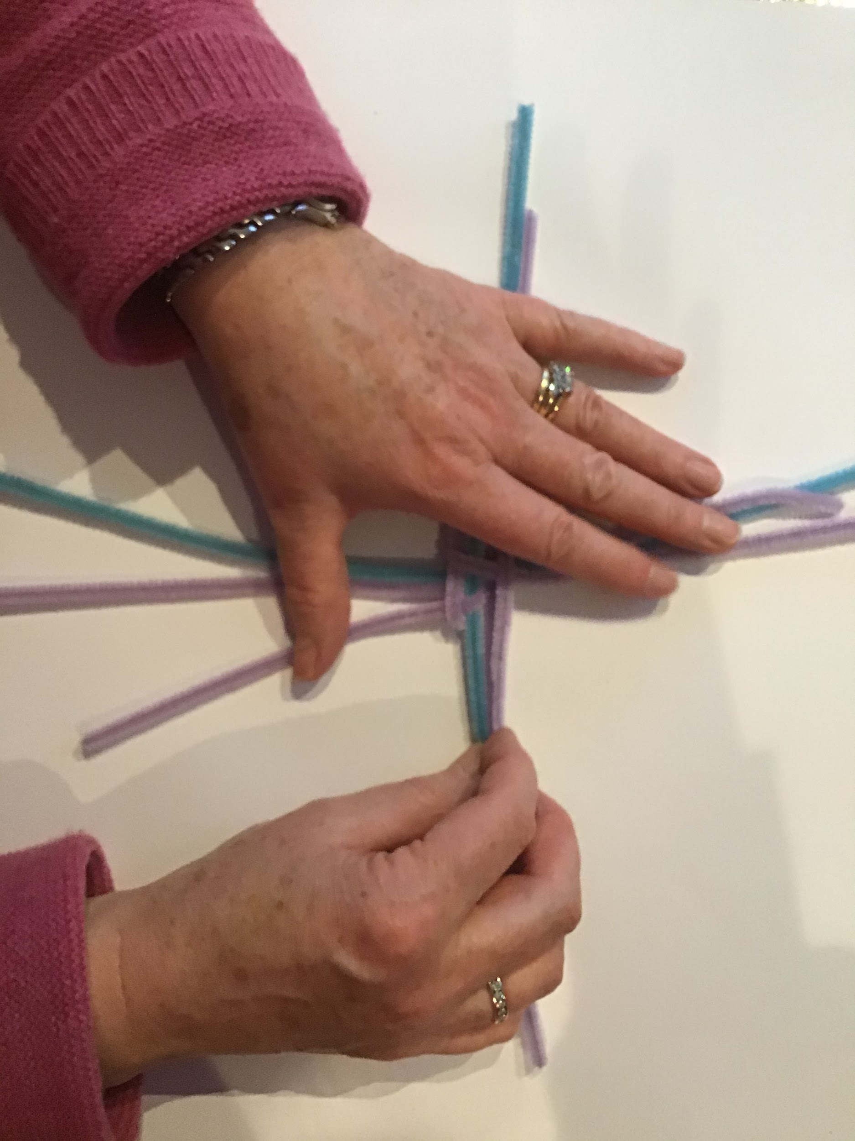
Step 6.Fold the fourth pipe cleaner over 12 o’ clock

Slide 8
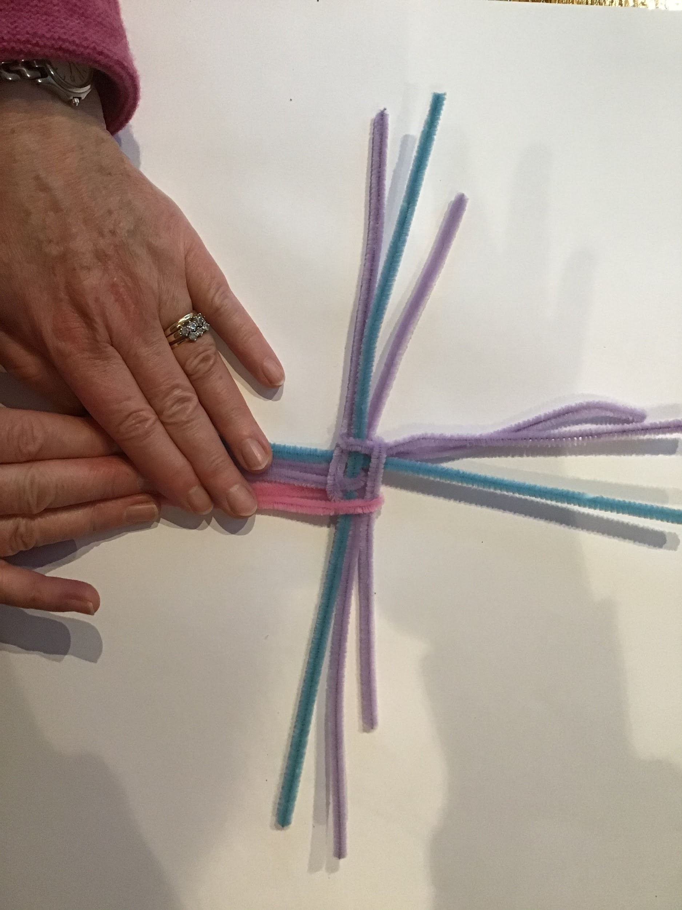
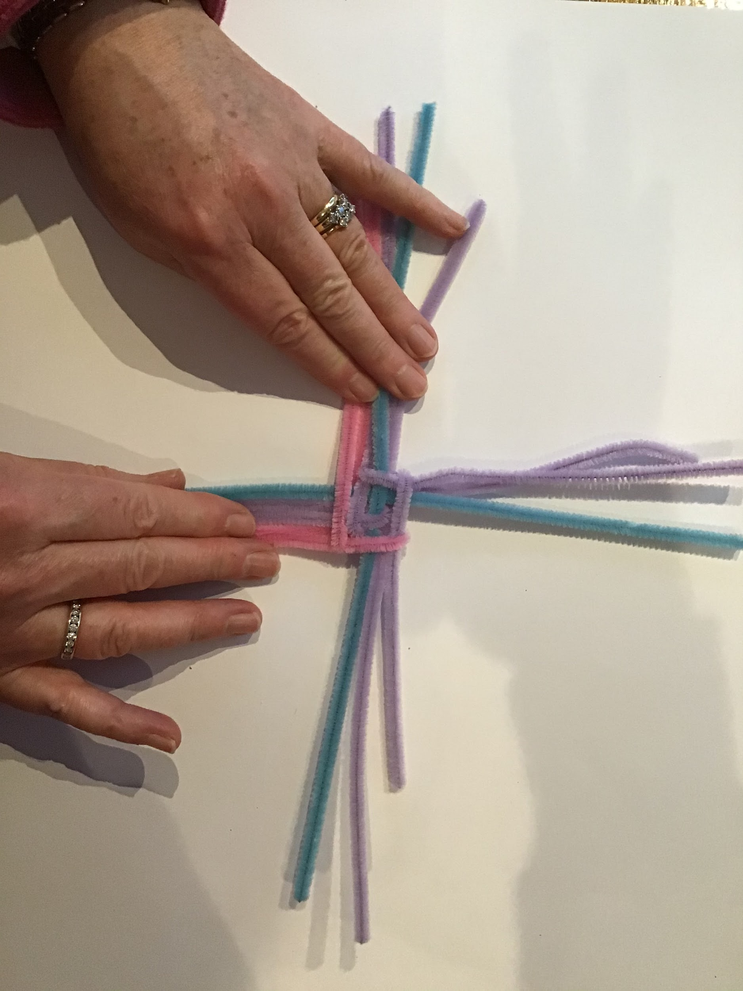
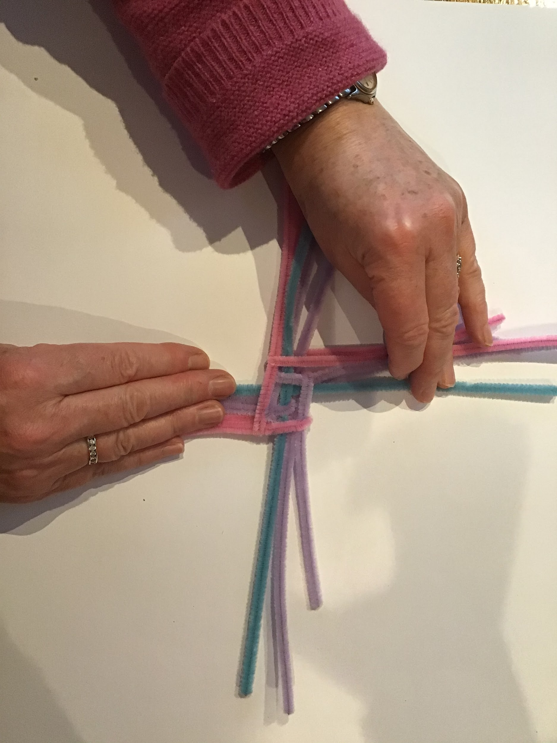
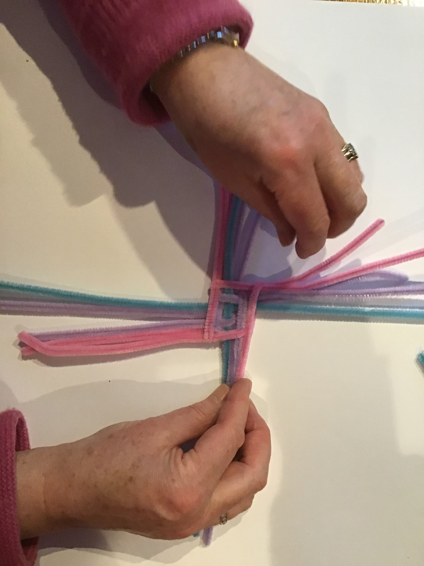
Repeat this process.
1
2

Slide 9
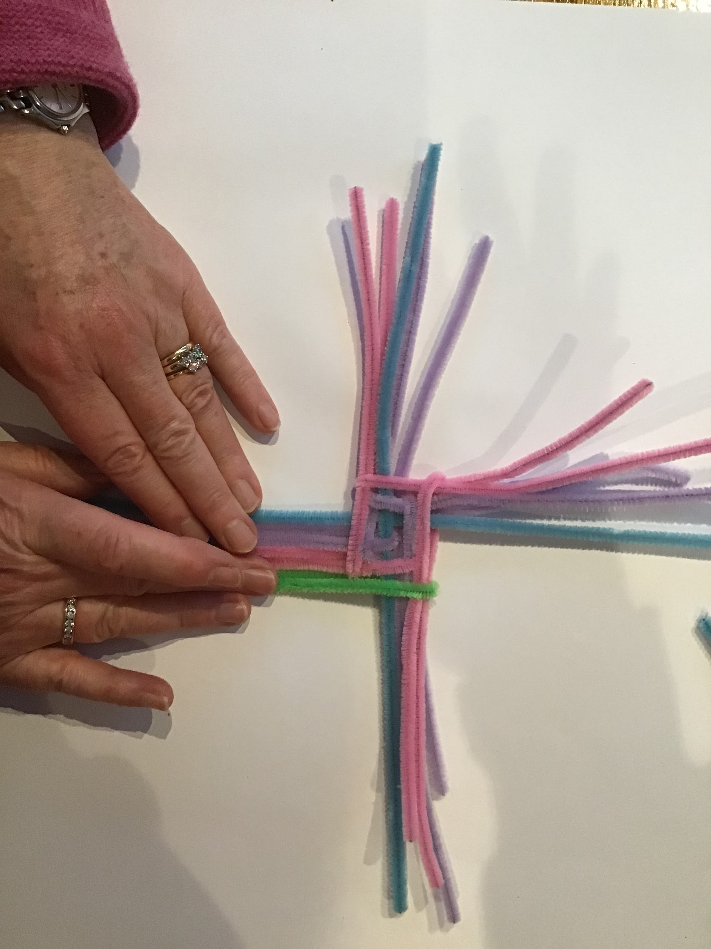
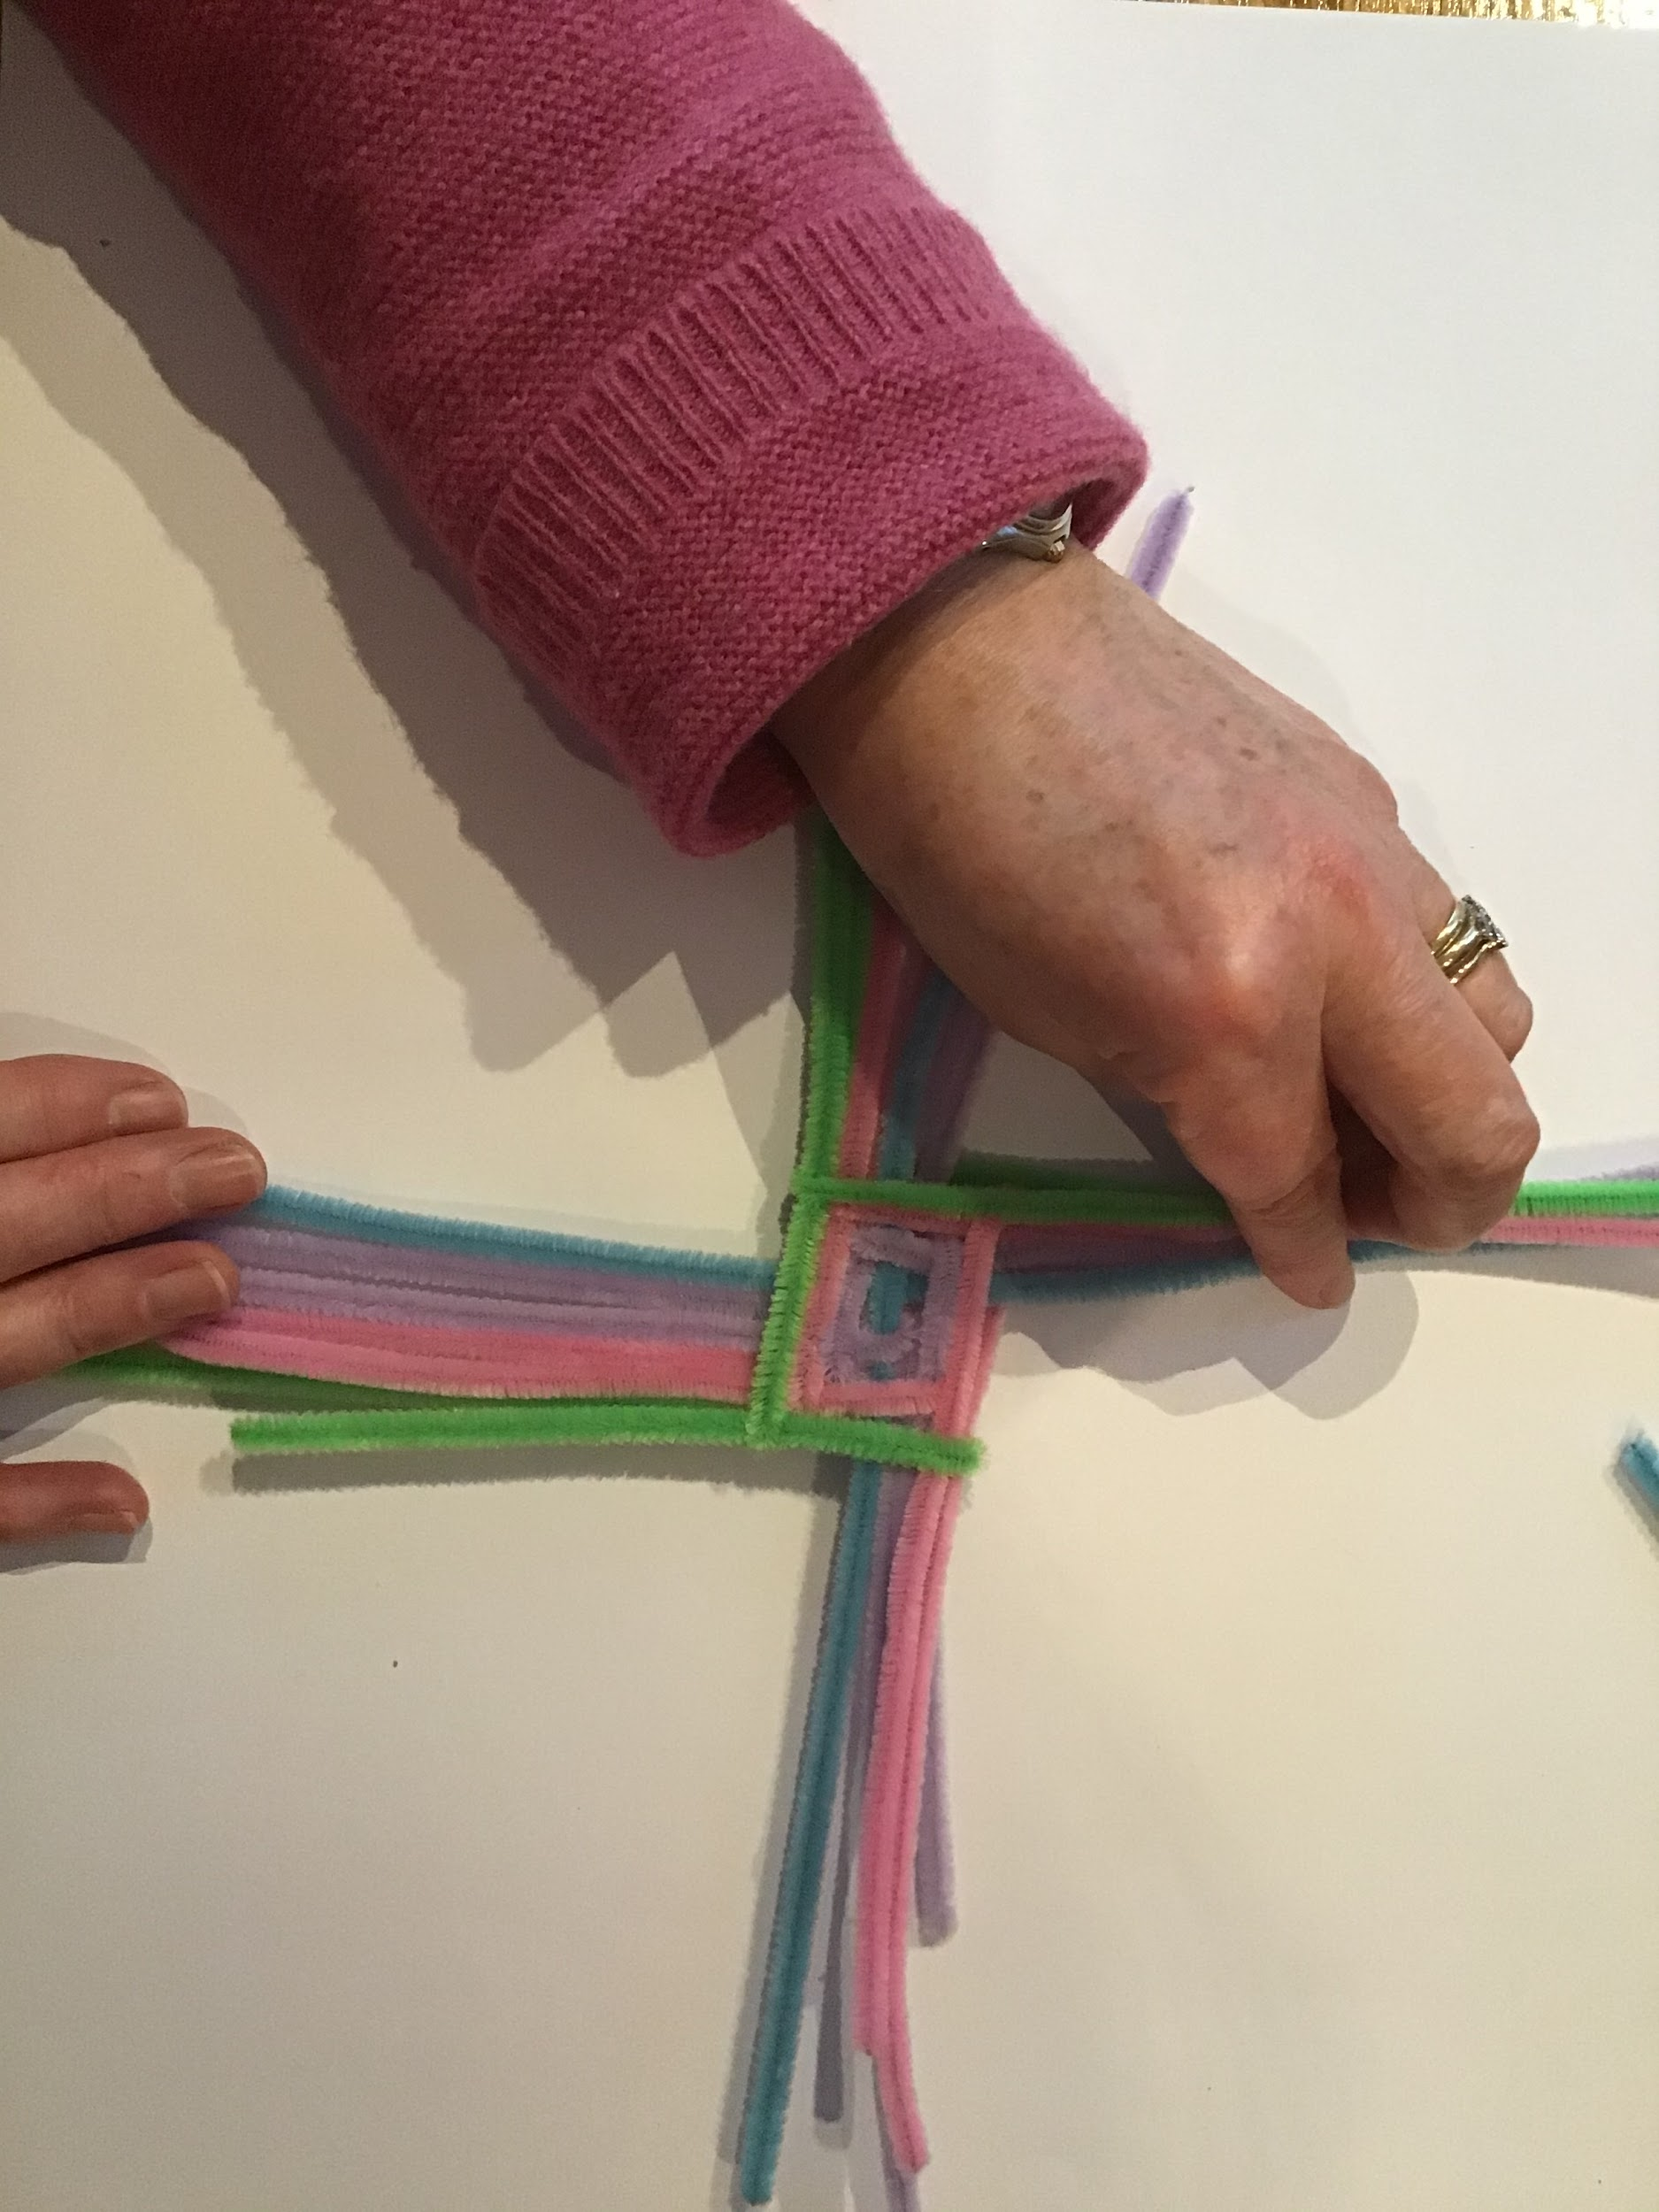
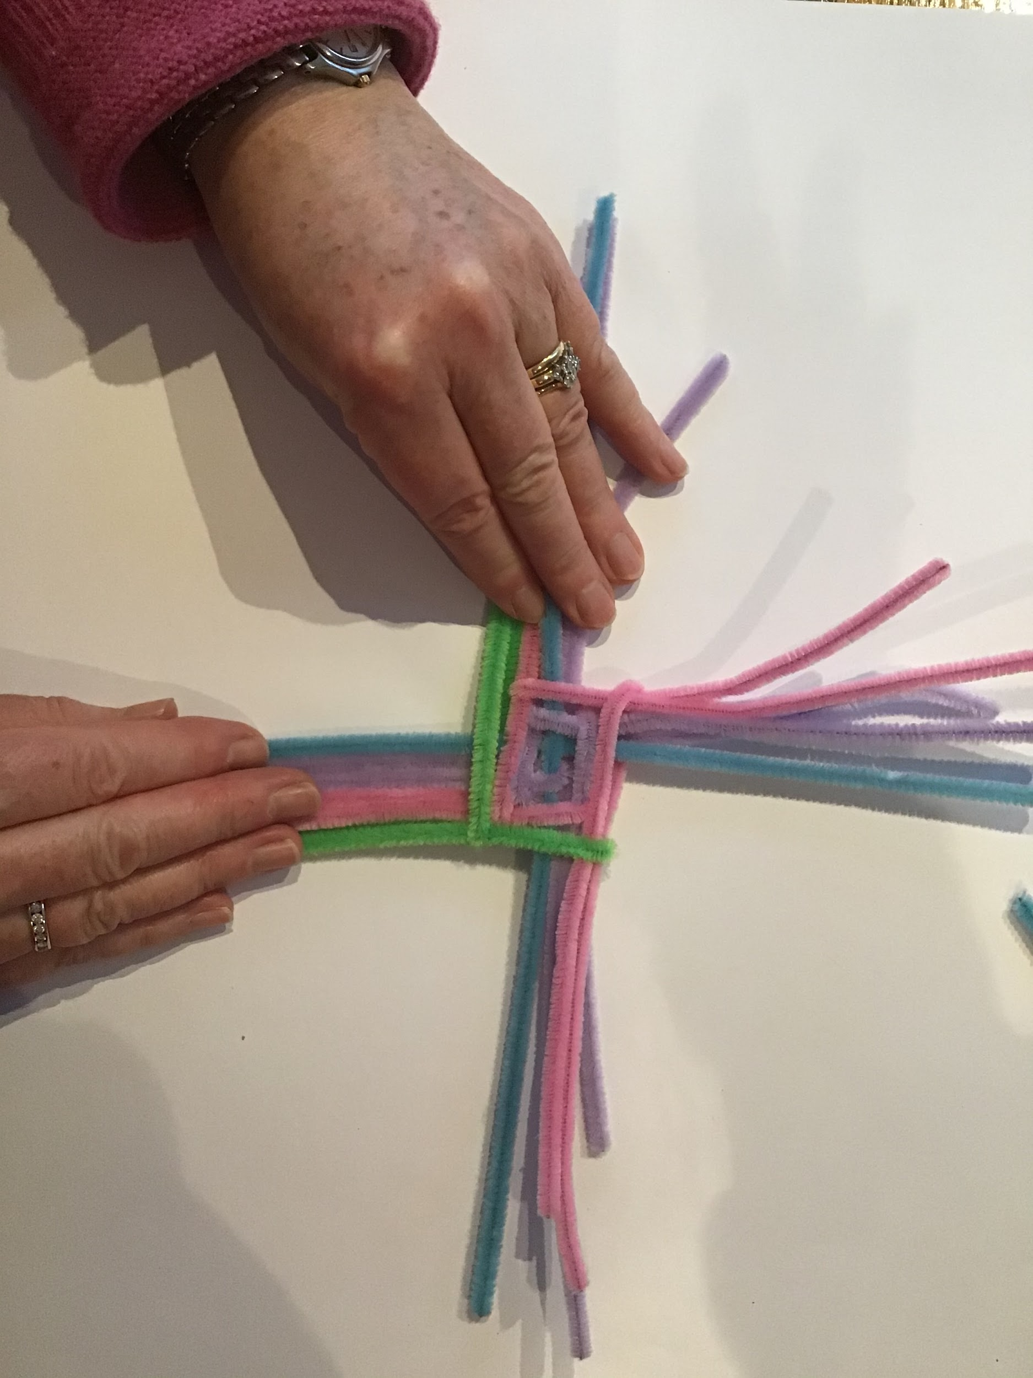
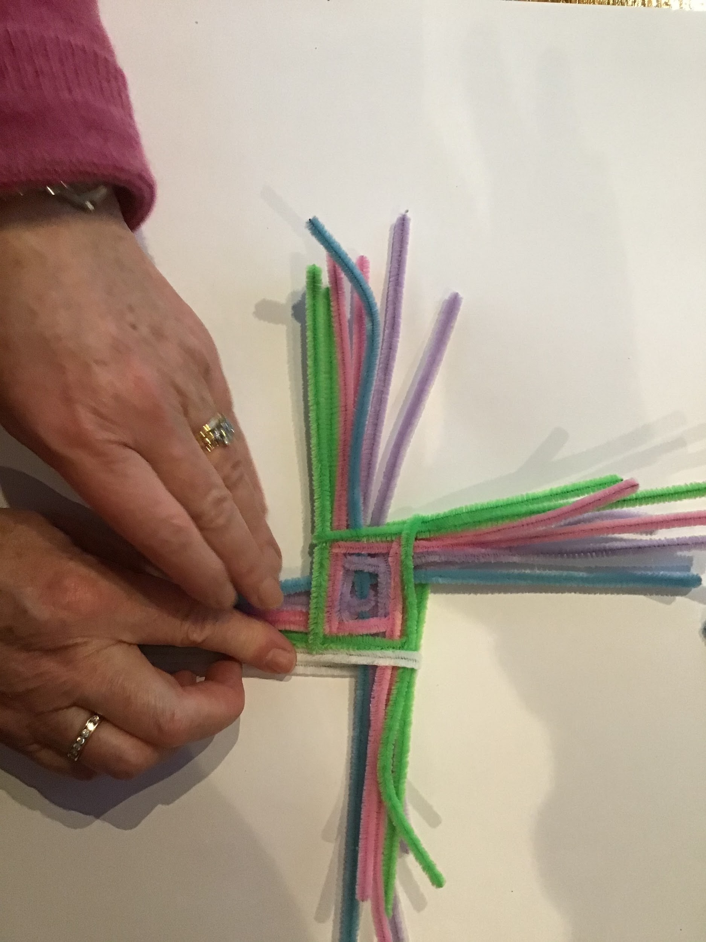
Repeat once more

Slide 10
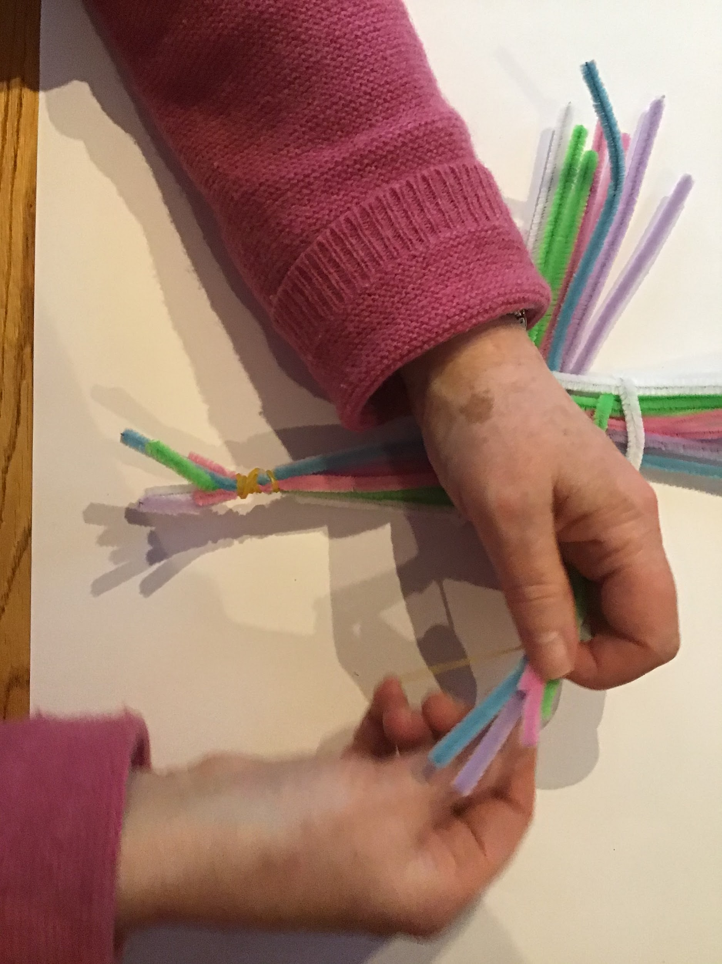
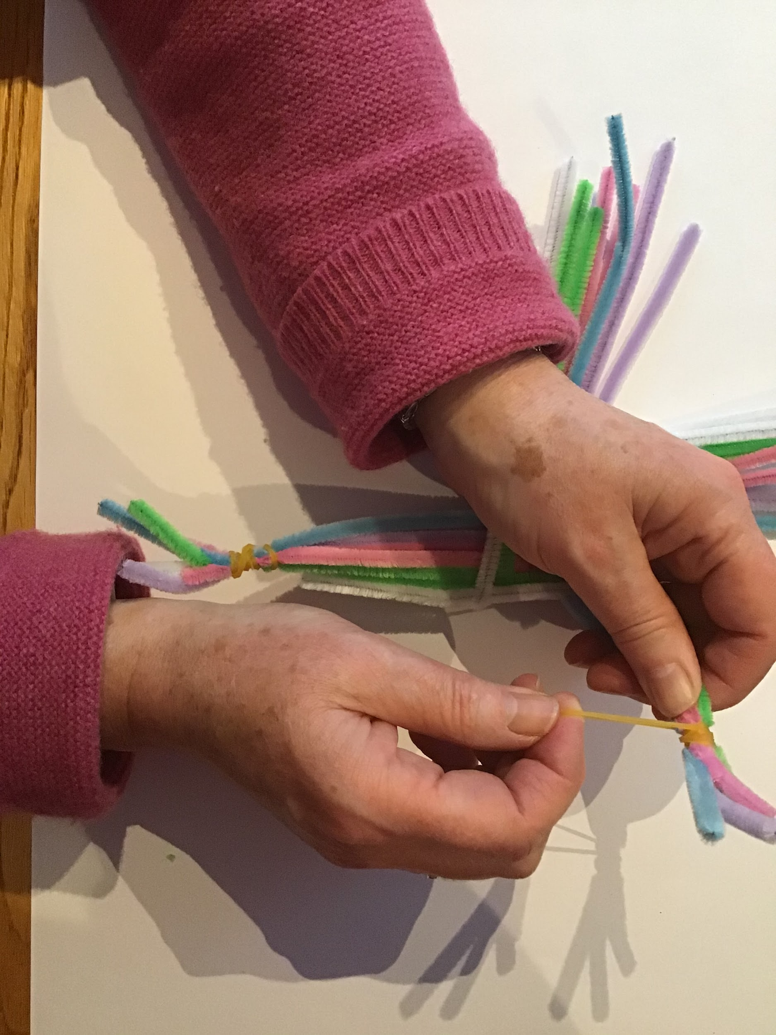
Secure the ends using elastic bands, string or thread

Slide 11
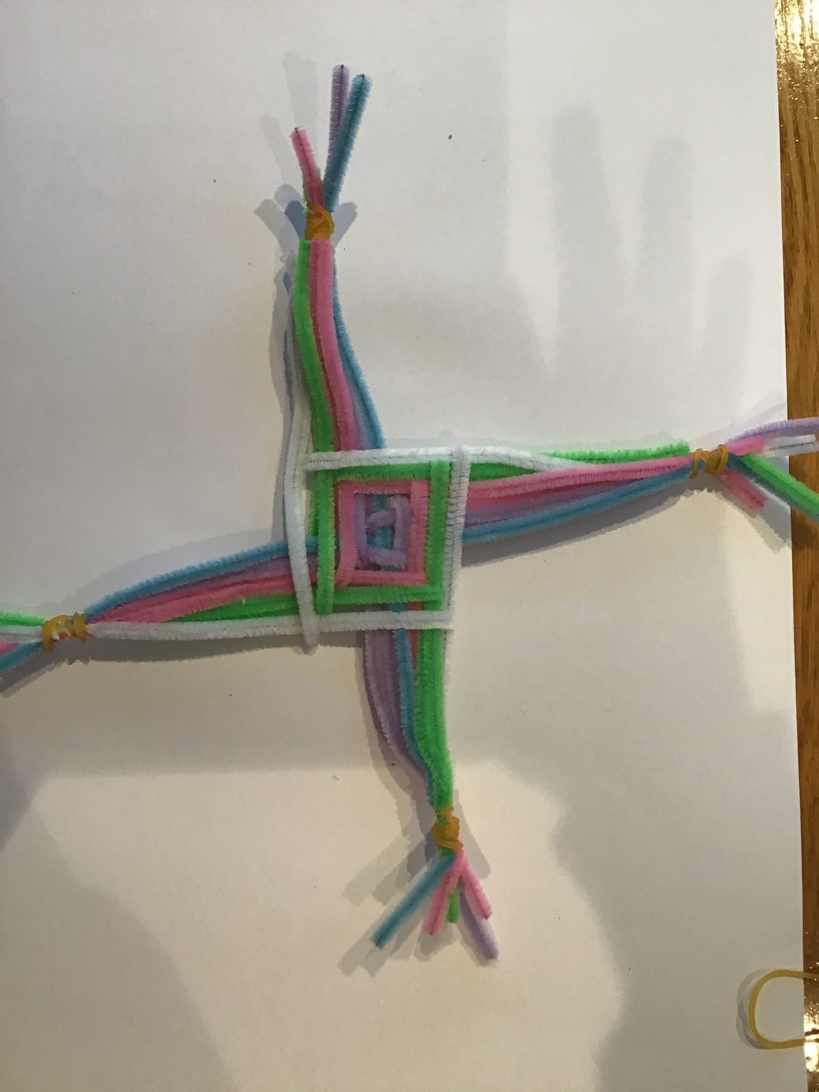
You own St Bridget’s cross

